Slide 1
Value-Driven Methodology
Overview

Slide 2
Key Milestones
Define domain model
Define customer focus methodology
Define action plan to capture unmet needs
Begin interviews with key stakeholders
Complete qualitative analysis
Draft survey for quantitative analysis
Conduct survey and capture data
Present recommendations
Based on the Strategyn Methodology (see next slides)

Slide 3
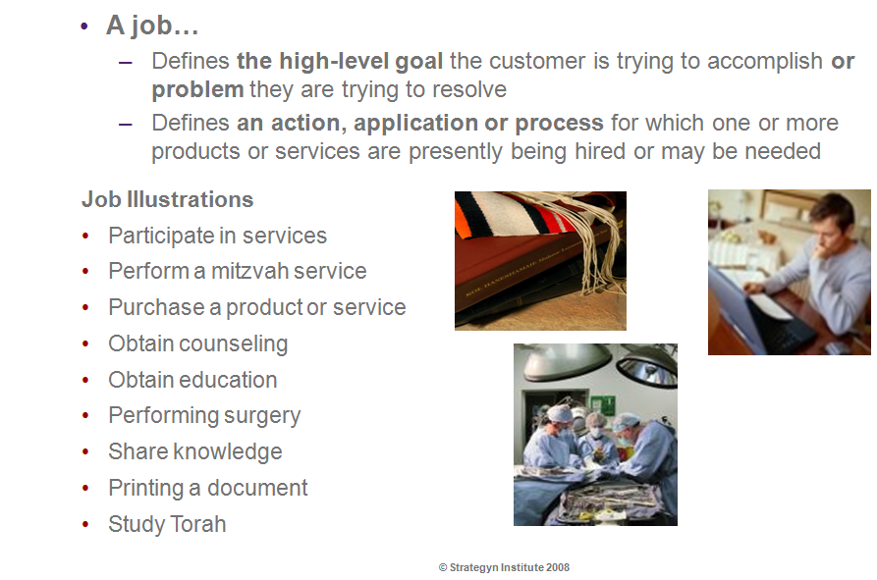
What is a Job ?

Slide 4
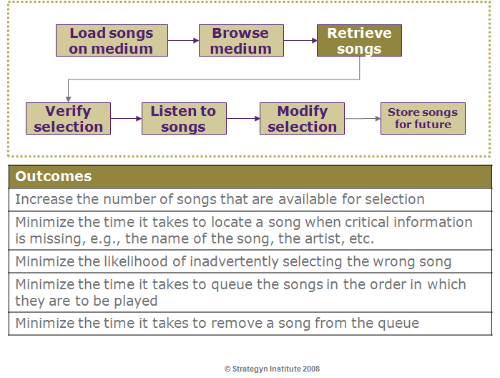
Example: Job of Storing & Retrieving Music

Slide 5
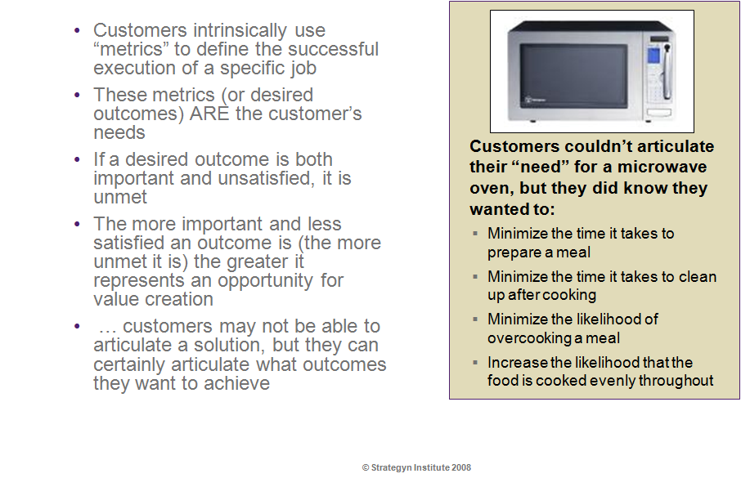
What are outcomes ?

Slide 6
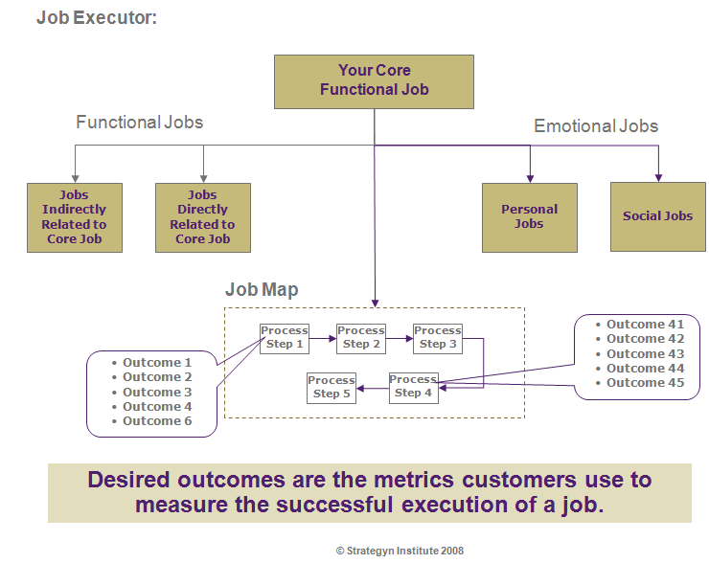
Model for Relating Jobs & Outcomes

Slide 7
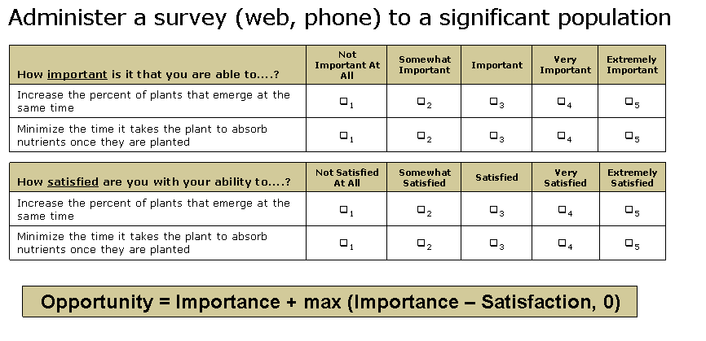
Capturing & Measuring Value

Slide 8
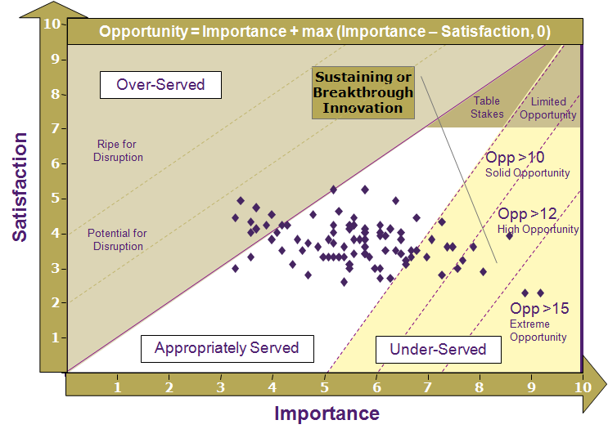
Identifying & Prioritizing Opportunities

Slide 9
Modeling Value Across the Continuum of Care
Provider
Jobs
Admissions
Quality Improvements
Practitioner
Jobs
Diagnosis
Administering
Drugs
Patient
Jobs
Obtaining
Information
Accessing
Care Facilities
Customer Satisfaction
Practitioner Satisfaction
Materials / Environment
Management
Providing
Information
Bedside Care
Procedures &
Protocols
Obtaining
Treatment
Preventing
Illness
Recovery &
Maintenance

Slide 10
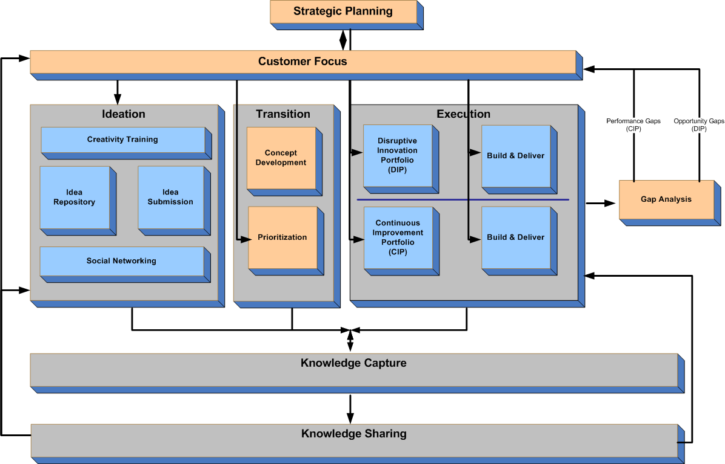
Driving Sustainable Value

Slide 11
Thank You

